Slide 1
Digital Portfolio
STUDENT NAME: S.Sathishwaran
REGISTER NO AND NMID: 222401231,asunm1102ai121
DEPARTMENT: B.Sc with AI
COLLEGE: Dharmamurthi Rao Bahadur Calavala Cunnan Chetty Hindu College,Madras university.

Slide 2
PROJECT TITLE
Student webpage portfolio

Slide 3


AGENDA
Problem Statement
Project Overview
End Users
Tools and Technologies
Portfolio design and Layout
Features and Functionality
Results and Screenshots
Conclusion
Github Link
3/21/2024 Annual Review

Slide 4

PROBLEM STATEMENT
As a student , showcasing skills, projects, and achievements online is essential. However, many students struggle with creating a professional, responsive portfolio that works well across devices. This project solves that by building a mobile-friendly student portfolio website using HTML, CSS, and JavaScript.

Slide 5

PROJECT OVERVIEW
The project is a personal portfolio website designed to present a student’s profile, skills, projects, and contact information in a clean, responsive layout. The portfolio adapts to both desktop and mobile devices, making it accessible for recruiters, teachers, and collaborators.

Slide 6

WHO ARE THE END USERS?
Students – to showcase their work and skills.
Recruiters/Employers – to quickly view skills and projects.
Peers & Mentors – to collaborate on projects or provide feedback.

Slide 7

TOOLS AND TECHNIQUES
Frontend: HTML5, CSS3, JavaScript.
Fonts: Google Fonts (Inter).
Hosting (Optional): GitHub Pages.

Slide 8
PORTFOLIO DESIGN AND LAYOUT
Header: Sticky navigation bar with logo and links (About, Projects, Skills, Contact).
Hero Section: Profile photo, introduction, and tagline.
About Section: Brief student introduction and career goals.
Projects Section: Two project cards displayed in a grid (responsive).
Skills Section: Tech stack badges (HTML, CSS, JavaScript, React, Python).
Contact Section: Contact form with JavaScript validation and success message.
Footer: Copyright info.
8

Slide 9
FEATURES AND FUNCTIONALITY
✅ Responsive design – works on both desktop and mobile.
✅ Sticky navbar – always accessible for easy navigation.
✅ Grid-based projects section – neatly showcases work.
✅ Interactive contact form – shows confirmation message on submit.
✅ Hover effects – improve user experience on cards and buttons.

Slide 10
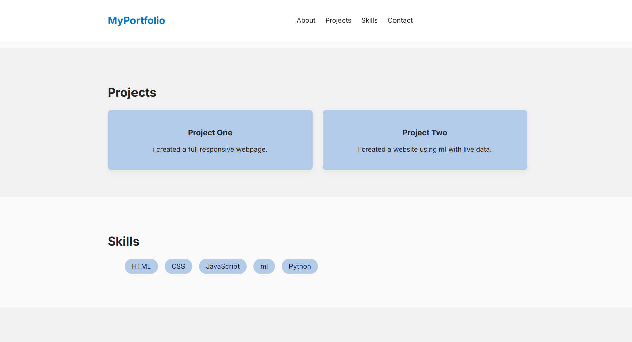
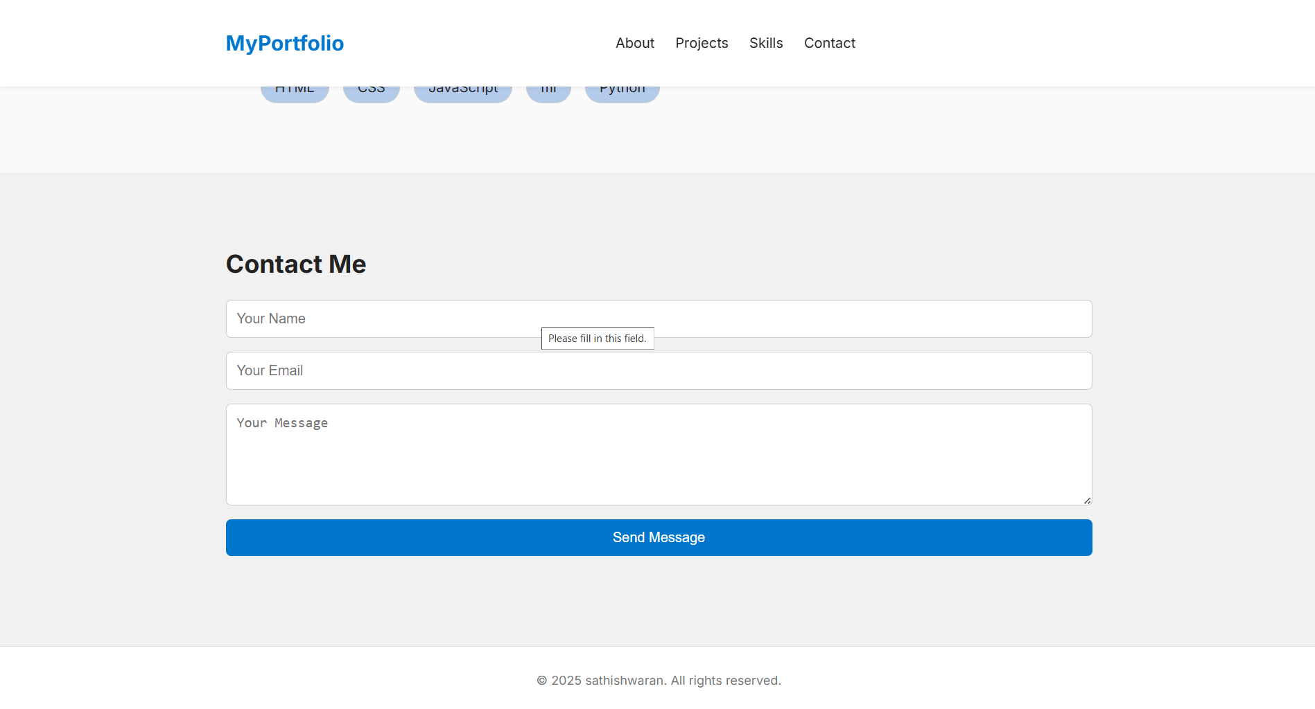
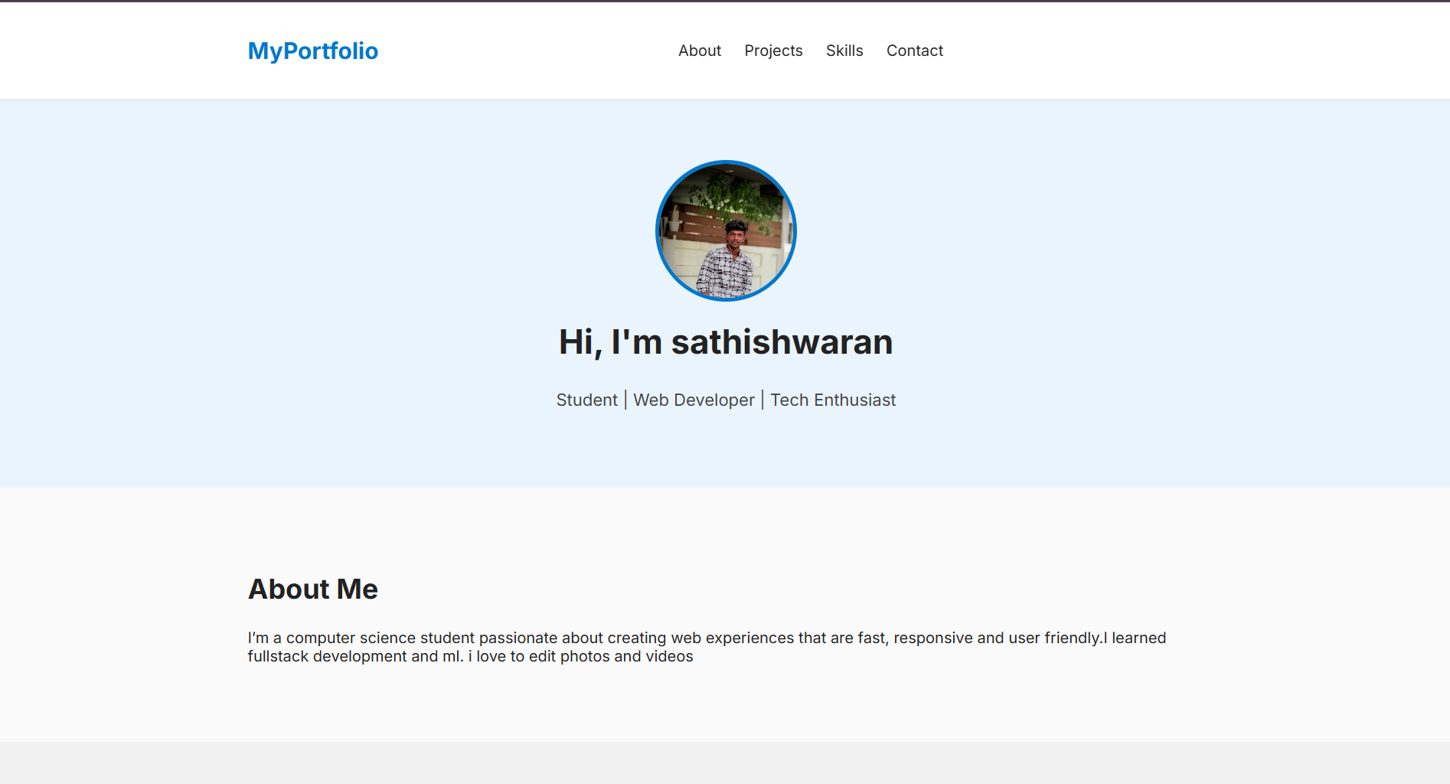
RESULTS AND SCREENSHOTS
10

Slide 11
GITHUB LINK

Slide 12
CONCLUSION
The portfolio website provides students with a professional online presence. It is lightweight, easy to customize, and mobile responsive. By expanding the projects section and adding integrations (like EmailJS for real emails), it can become a complete digital resume.
12

